Slide 1
Programação Paralela e Distribuída
Smart Contracts
Over Ethereum
GITE/GO
Júnio César da Silva MSc.

Slide 2
Agenda
Nick Szabo (Satoshi?)
Plataforma Ethereum
Aplicações Distribuídas (Dapps)
Organizações Autônomas Descentralizadas (DAO)
Remix IDE, Solidity
PPDSmart
Trablhos Futuros

Slide 3
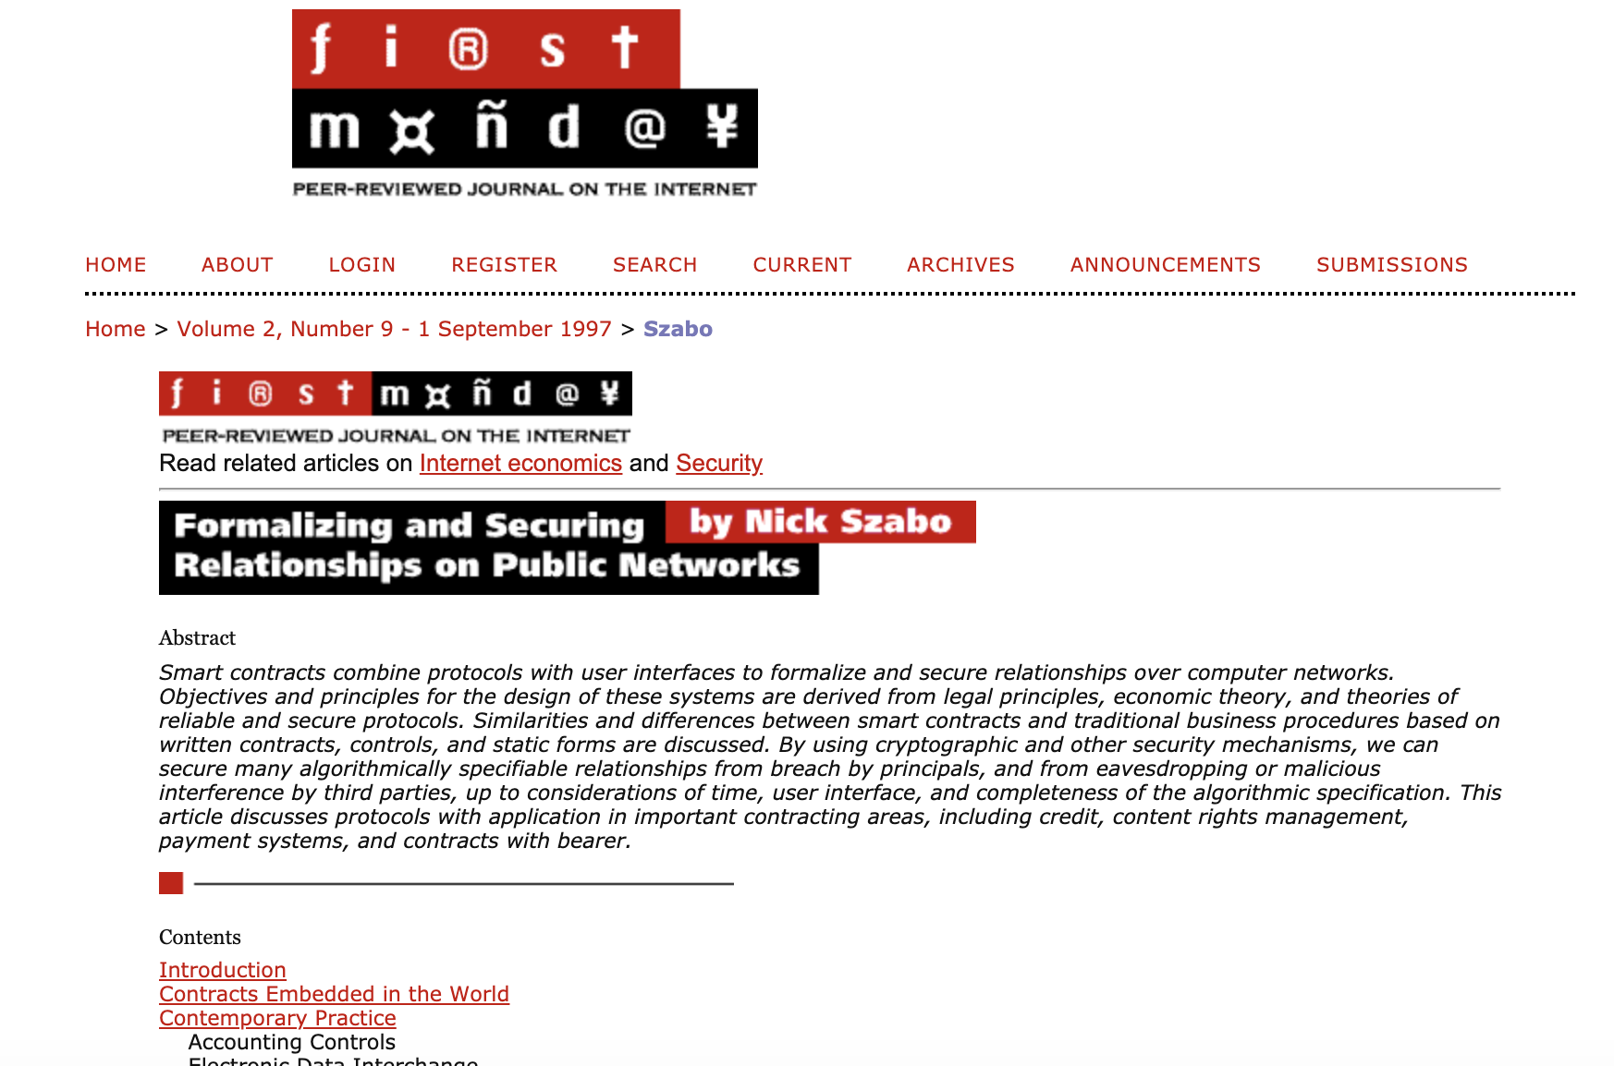
Contratos Inteligentes - Nick Szabo/1997

Slide 4
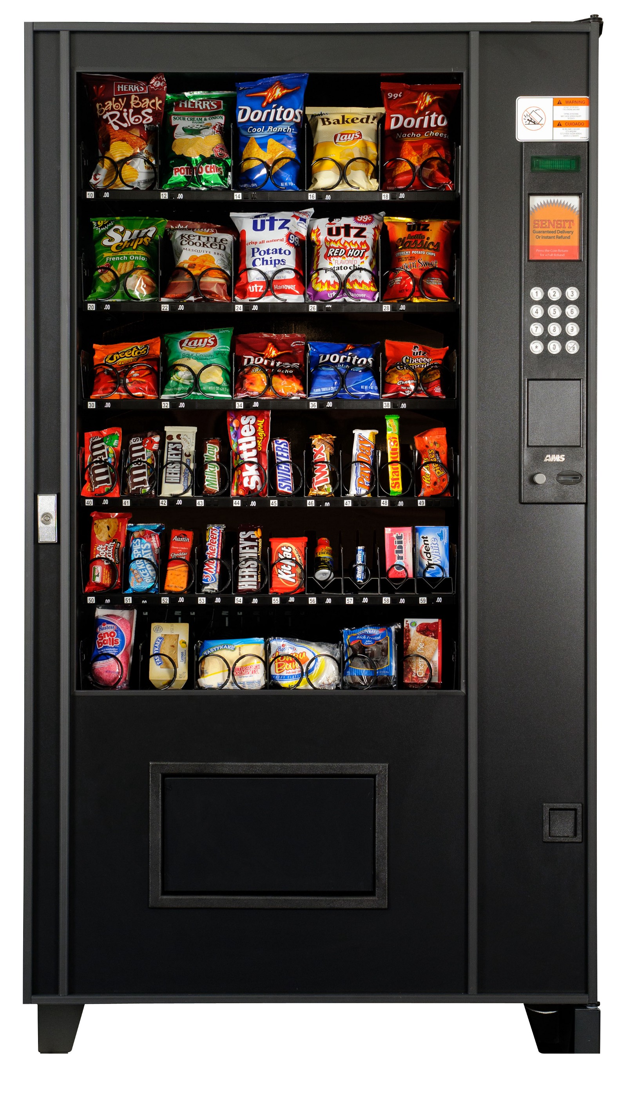
A canonical real-life example, which we might consider to be the primitive ancestor of smart contracts, is the humble vending machine. Within a limited amount of potential loss (the amount in the till should be less than the cost of breaching the mechanism), the machine takes in coins, and via a simple mechanism, which makes a freshman computer science problem in design with finite automata, dispense change and product according to the displayed price. The vending machine is a contract with bearer: anybody with coins can participate in an exchange with the vendor. The lockbox and other security mechanisms protect the stored coins and contents from attackers, sufficiently to allow profitable deployment of vending machines in a wide variety of areas.
Nick Szabo - 1997

Slide 5

Plataforma Ethereum
Vitalik Buterin et al.

Slide 6
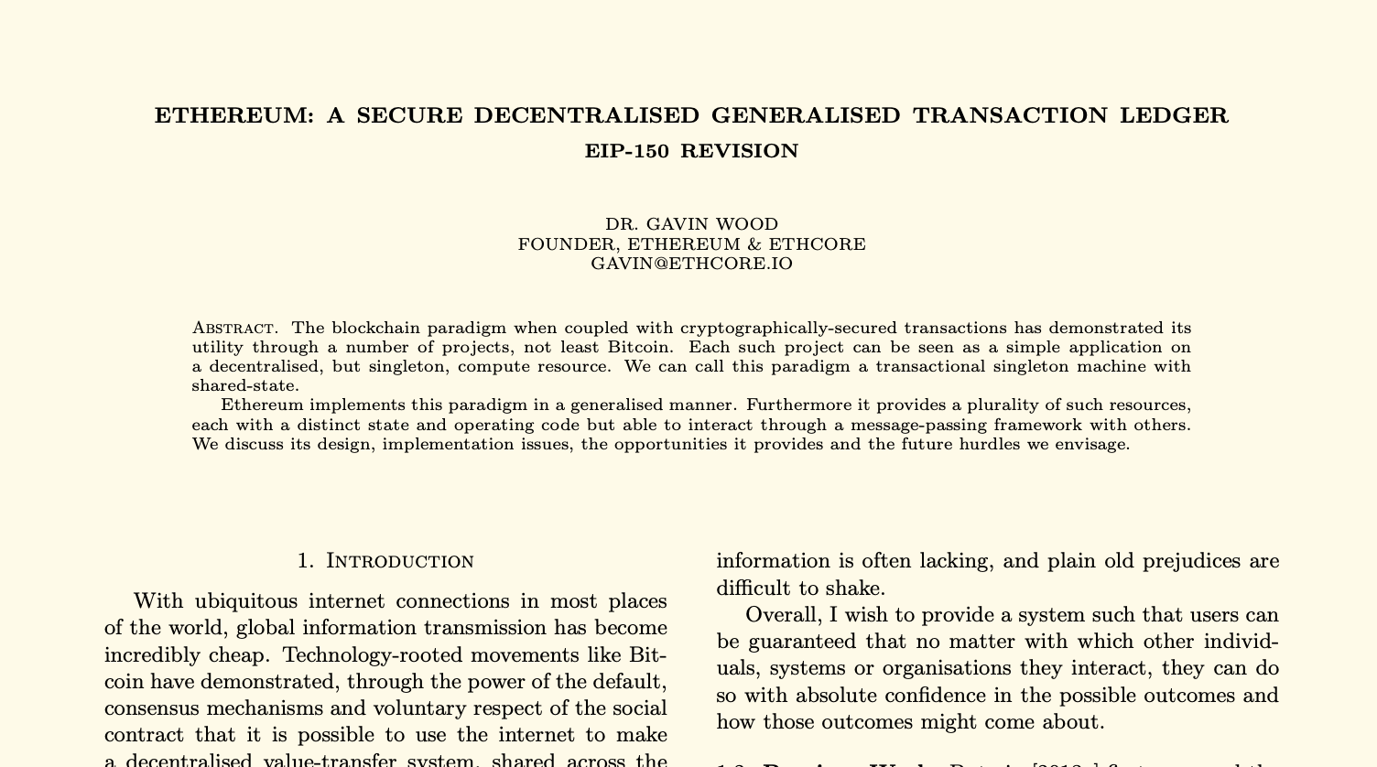
The Yellow Paper - 2013

Slide 7
Podemos chamar esse paradigma de uma máquina única transacional com estado compartilhado.

Slide 8
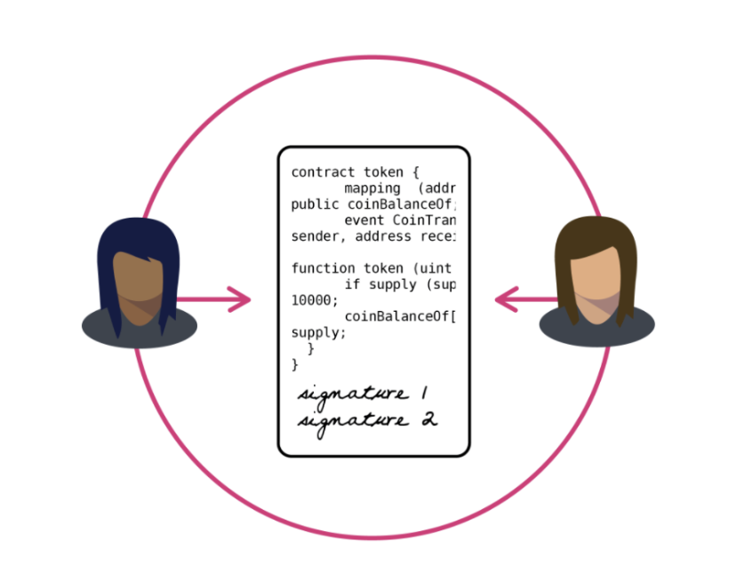
Contrato Inteligente

Slide 9
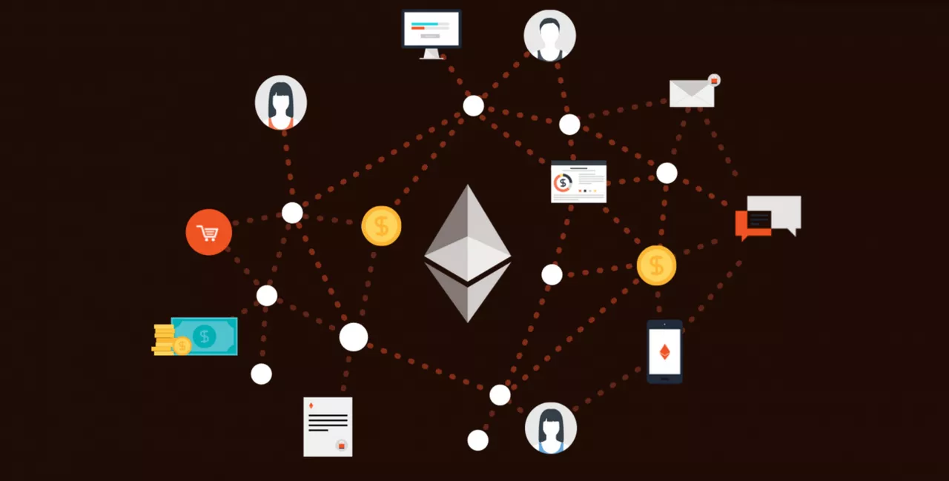
DApps

Slide 10
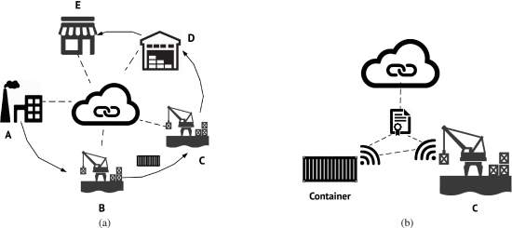
An asset tracking example using smart contracts and IoT. In Fig. 4a (left) a container leaves the manufacturing plant (A), reaches the neighboring port (B) via railway, gets transported to the destination port (C), and then to the distributor’s facilities (D), until it reaches the retailer’s site (E). In Fig. 4b (right), we focus on the B-C stage. The carrier of the container performs a handshake with the dock at the destination port (C) to confirm that the container is delivered to the expected location. Once that handshake is completed, it posts to a smart contract to sign the delivery. The destination port follows along to confirm reception. If the node at C does not post to the contract within an acceptable timeframe, the shipping carrier will know and can initiate an investigation on the spot.

Slide 11
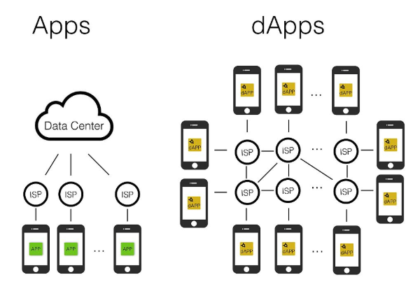

Slide 12
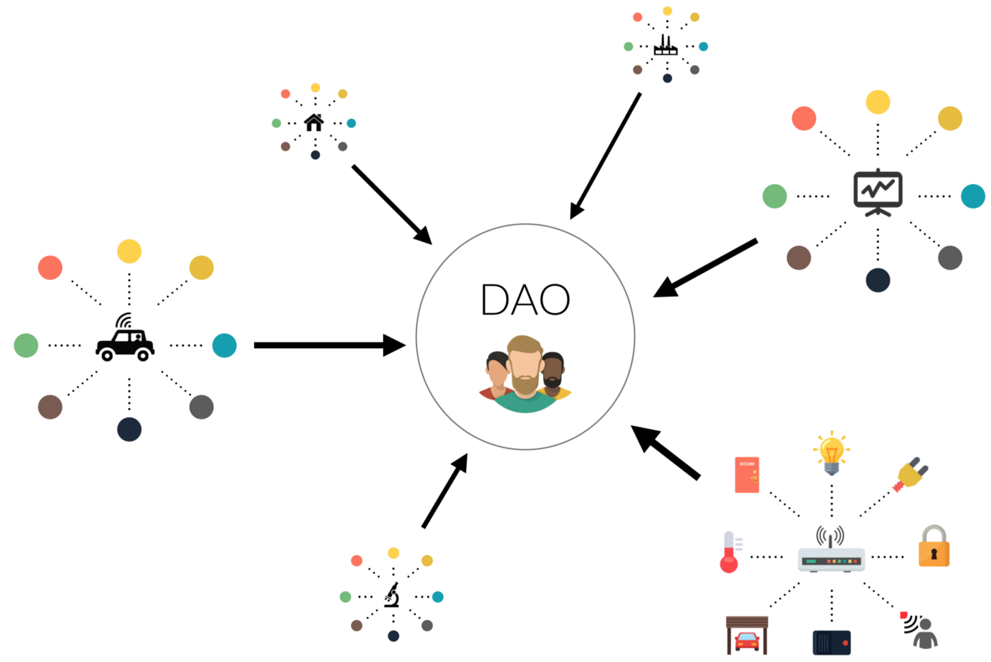
Organização Autônoma Descentralizada

Slide 13
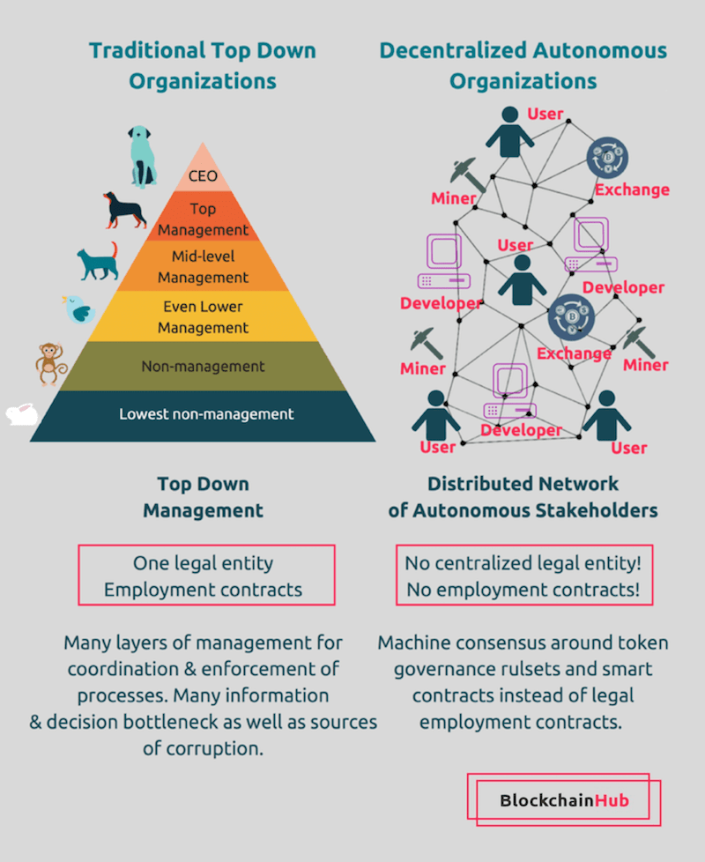

Slide 14


16/06/2016
Ethereum hackeada!

Slide 15
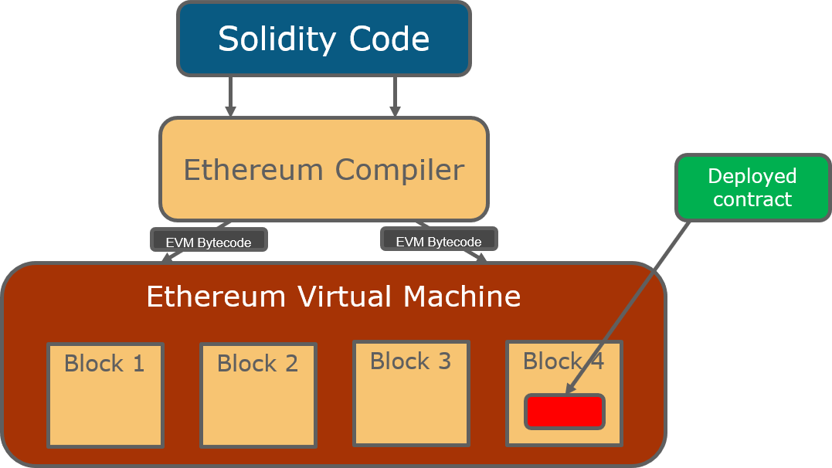
A linguagem Solidity

Slide 16
Trabalhos Futuros
Criar Dapps utilizando o midleware Web3

Slide 17
Obrigado!!

